Slide 1

Agentic FedGrid: Autonomous Privacy-Preserving Threat Detection
Department of Information Science Engineering
Final Year Project 2025-26
Synopsis Presentation
By:
Mohith Kumar M-1JS23IS090
Anusha B-1JS23IS016
Lokesh Kumar Yadav-1JS22IS065
Rohan C Ravi-1JS24IS410

Slide 2
Overview
Introduction (Abstract)
Project Overview
Objectives
Literature Survey
Project Scope and Deliverables
Methodology

Slide 3
Introduction
Traditional centralized intrusion detection compromises privacy and incurs high cloud costs. We introduce Agentic FedGrid, a decentralized framework deploying autonomous edge agents. Using Tabular Transformers, agents detect threats locally and share only mathematical updates via Federated Averaging on a serverless AWS orchestrator, guaranteeing data privacy and scalable, zero-cost cyber defense.

Slide 4
Project Overview
The Problem Statement (The Need)
  The Privacy Bottleneck: Organizations cannot legally or safely share sensitive network traffic logs to train centralized AI models.
  Failing Defenses: Traditional rule-based firewalls and static Intrusion Detection Systems (IDS) are ineffective against complex zero-day attacks and Advanced Persistent Threats (APTs).
  Cost & Latency: Uploading massive amounts of raw edge-device data to the cloud for security analysis is too slow and heavily inflates cloud computing costs.

Slide 5
Objective
Major Objective of the project
To engineer a decentralized, privacy-preserving Intrusion Detection System (IDS) that detects and neutralizes zero-day threats at the edge without ever exposing raw network logs to the cloud.
Important Goals
Autonomous Edge Defense: Deploy Agentic AI nodes capable of locally monitoring traffic and blocking malicious payloads in real-time without cloud authorization.
Privacy-Preserving Collaboration: Implement Federated Learning (FedAvg) so nodes share only mathematical intelligence, keeping all user data strictly on-device.
Zero-Cost Orchestration: Architect a highly scalable, serverless cloud backend to securely aggregate AI weights at zero compute cost.
Advanced Pattern Recognition: Utilize Tabular Transformers to detect the hidden, sequential patterns of complex attacks like Advanced Persistent Threats (APTs).

Slide 6
Literature Survey
Authors/Year | Primary Focus | Proposed Architecture | Keyfindings | Drawbacks
Muthuswamy et al. (2026) | Federated IoT Intrusion Detection | Hybrid Transformer + XGBoost + Fusion Head | Utilized LoRA adapters to reduce FL communication overhead by ~89.5% while managing severe class imbalance. | Challenged by complex, low-frequency web and injection attacks (like SQLi and XSS) because their payloads closely resemble legitimate traffic.
Devi et al. (2025) | Vision Transformers for Cybersecurity | FAT-ViT (Federated Adaptive Training + ViT-Lite) | Converted network traffic to 2D visuals to capture spatial relations ; used Contrastive Adversarial Training to improve robustness against evasion. | The process of converting network traffic logs into two-dimensional visual representations introduces mandatory preprocessing overhead before the AI can analyze the data.

Slide 7
Literature Survey
Authors/Year | Paper | Proposed Architecture | Key findings | Drawbacks
Vijetha (2026) | Self-Adaptive Threat Detection | AISAF (CNN-LSTM-Transformer + Meta-Optimization) | Autonomously detects concept drift without explicitdensity estimation and selectively retrains submodules, achieving rapid recovery. | Currently relies on fixed window segmentation, which may underperform in ultra-low-latency streams where drift occurs at sub-millisecond timescales. Explainability remains feature-centric and lacks causal reasoning.
Panwar & Abdelrahman (2025) | Agentic AI Review | N/A (Literature & Framework Review) | Outlined the shift to autonomous Agentic AI, highlighting the need for self-learning security models and human-AI collaboration. | Highlights inherent risks in autonomous systems, including AI bias from training data, susceptibility to adversarial manipulation, and the dangers of completely removing human oversight.

Slide 8
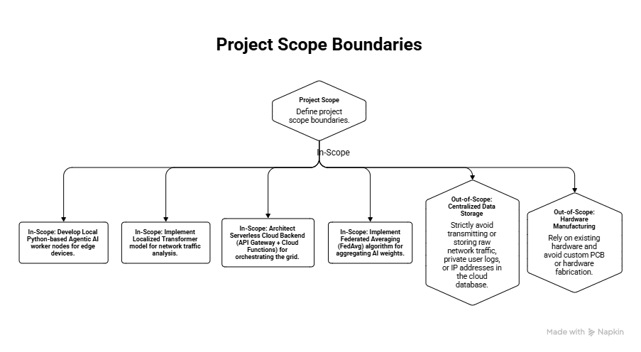

Slide 9
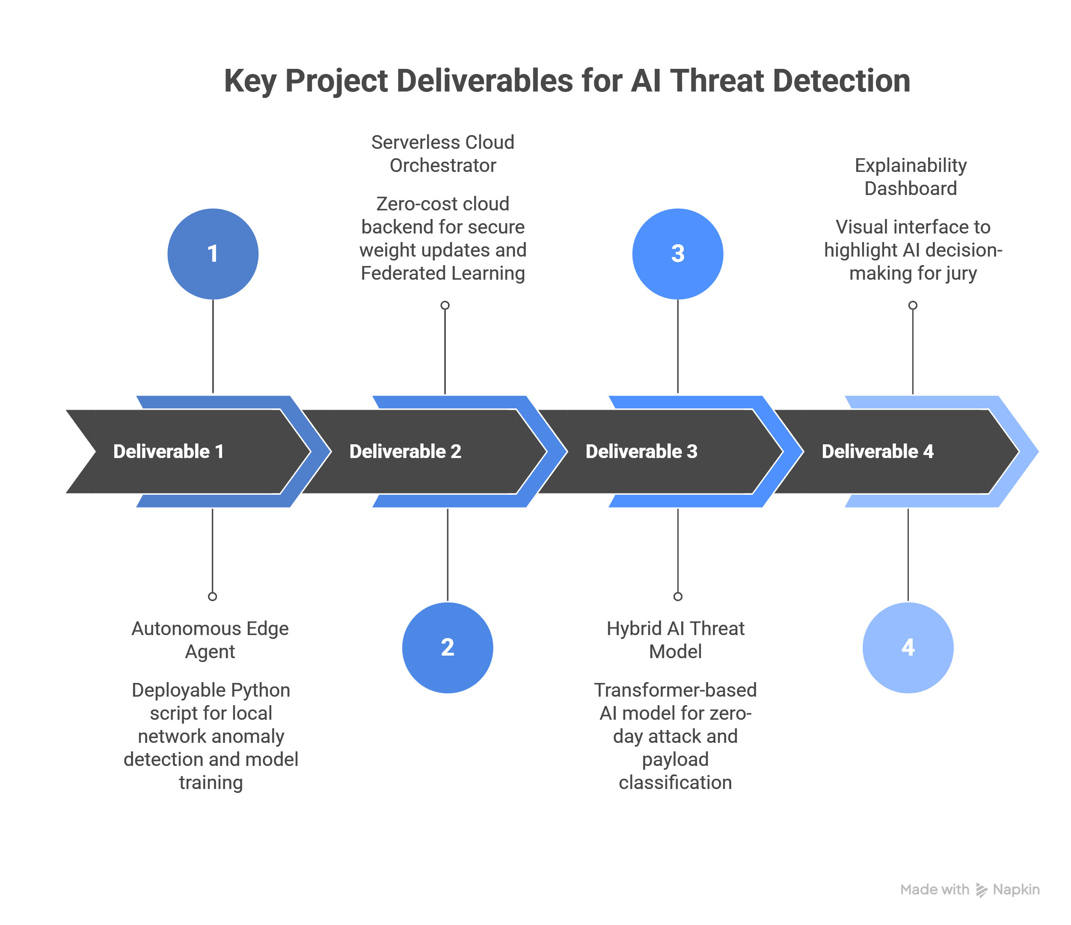

Slide 10
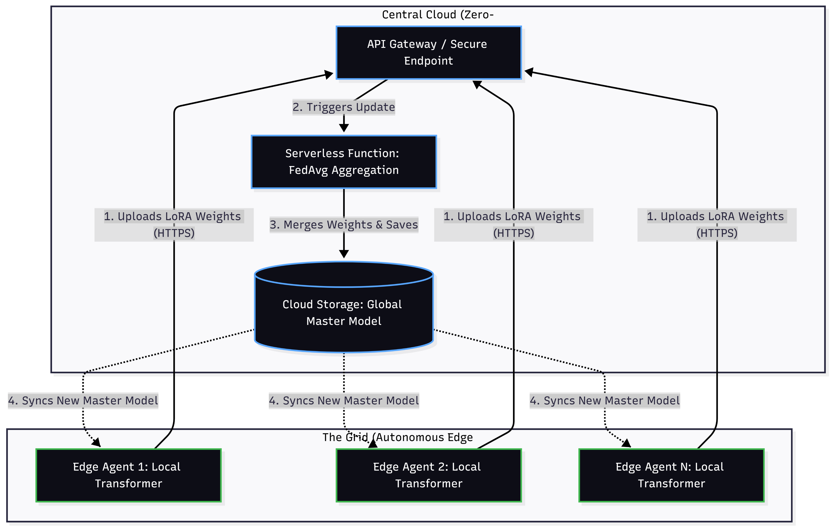
Methodology

Slide 11
Methodology
Techniques, Tools & Technologies
Edge Compute (Worker Nodes): Python, PyTorch (for the training loop), Tabular Transformers.
Cloud Orchestration (The Brain): AWS API Gateway (secure bridging), AWS Lambda (FedAvg aggregation), and AWS S3 (master model repository).
Data & Threat Simulation: mitmproxy (for livetraffic parsing) and the UNSW-NB15,CICIDS17,CICIDS18,BoT-IoT,CICIoT2023

Slide 12


